Slide 1
MEDICINES & SIDE EFFECT ANALYSIS
TEAM
LOKESH.P
ARUNA.Y
PAVITHRA.G
SANDHYA RANI
YAMINI.R
ARPIT
TIRUMALA RAYA
FACULTY GUIDE
VINOD
HIMAVANTH

Slide 2
BUSINESS PROBLEM
THE CUSTOMERS ARE FACING AN ISSUE IN SELECTING A DRUG TO RECOVER FORM THE ILLNESS. HENCE IT IS MANDATORY TO CONSULT A DOCTOR TO GET THE CORRECT DRUG.
BUSINESS OBJECTIVE
This product could be helpful for companies like 1mg to provide detailed rating of the side effects of the product over their site. It could also be helpful for the patients who are buying drugs online to check the side effects of the drugs before buying it.

Slide 3
PROJECT ARCHITECTURE
Step-1 : Data set details collection
Step-2 : Data cleaning
Step-3 : EDA phase
Step-4 : Models Building(Build as many as u can)
Step-5 : Finalize best model.
Step-6 : Compare actual and predicted values.
Step-7 : Deploy the finalized model and draw insights for that.(USING FLASK)

Slide 4
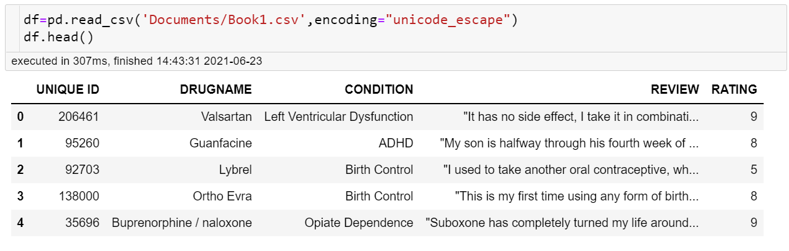
DATA SET COLLECTION

Slide 5
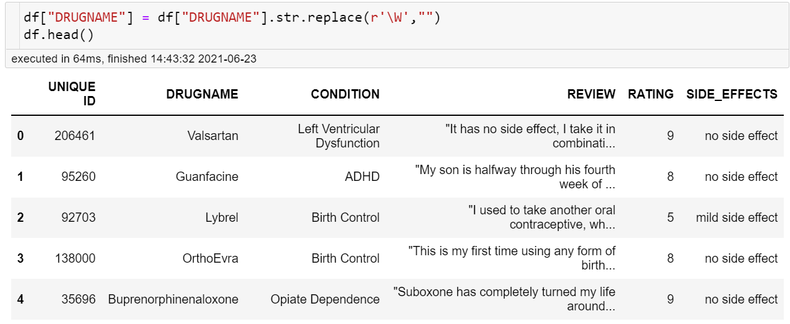
DATA CLEANING

Slide 6
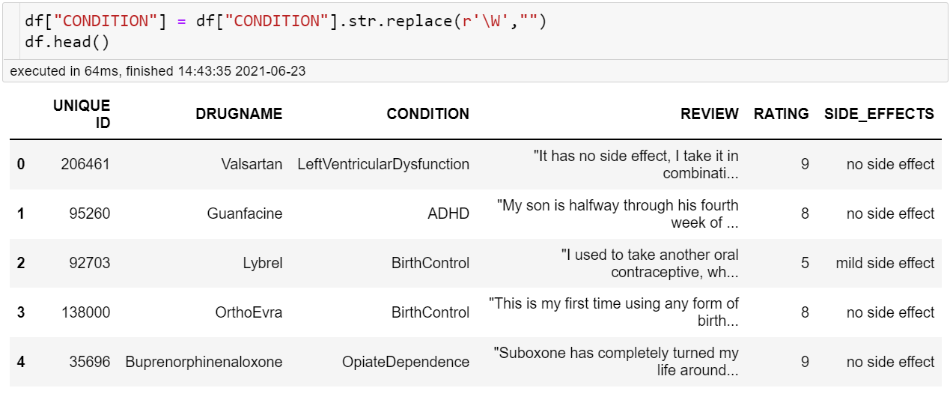

Slide 7
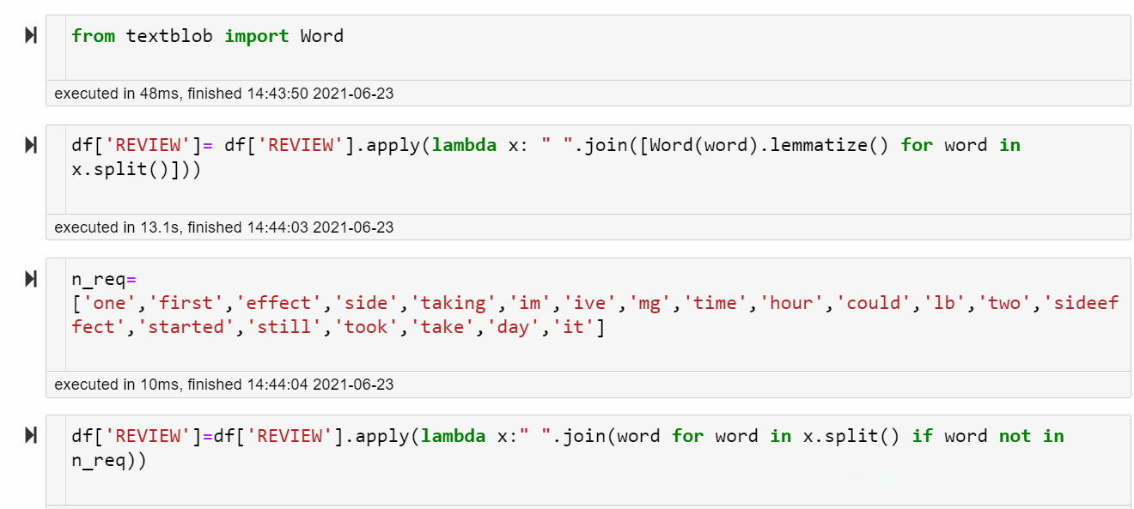

Slide 8
Exploratory Data Analysis(EDA)
DATA ANALYSIS
REMOVING NULL VALUES
DRUG NAME’S CLEANING
CONDITION’S CLEANING
REVIEW’S CLEANING
ADDING NEW COLUMN’S(EFFECTIVENESS)
BUILDING WORD CLOUD’S
VISUALIZATION OF DATA
SENTIMENT ANALYSIS
EXTRACTING SIDE EFFECTS FROM REVIEWS

Slide 9
WE PERFORMED SOME BASIC STATISTICAL OPERATIONS AS FOLLOWING
df.info()
df.describe()
df.isnull().any()
df.isnull().sum()
df.dropna(inplace=True)

Slide 10
LIBRARIES USED
PANDAS
NUMPY
MATPLOTLIB
SEABORN
SPACY
WORD CLOUD
NLTK
SKLEARN
REQUEST

Slide 11
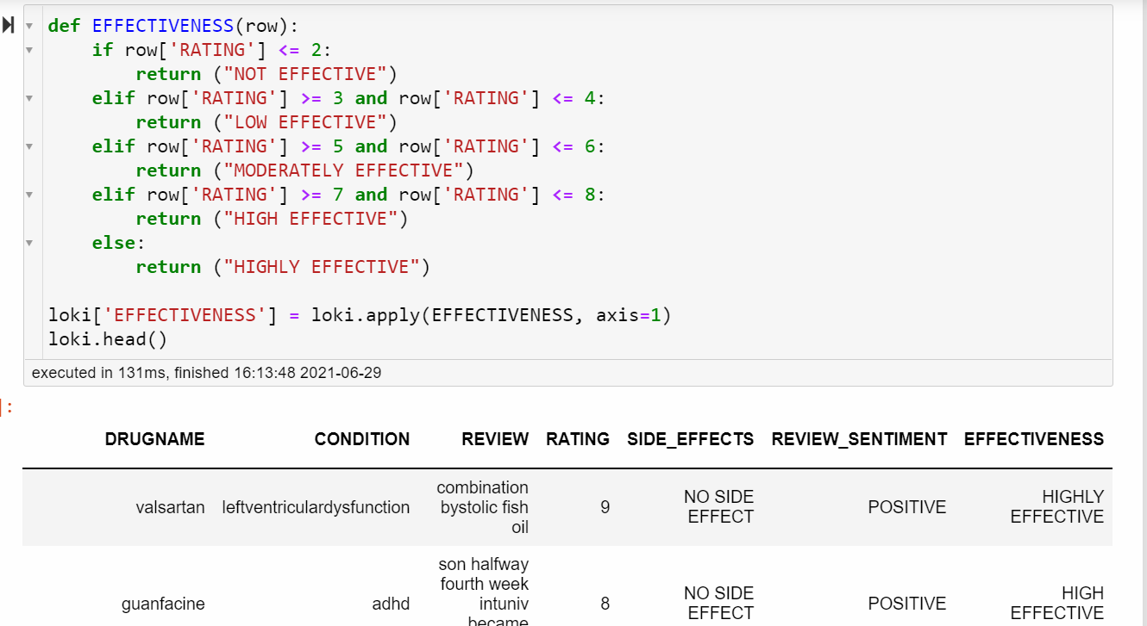

Slide 12
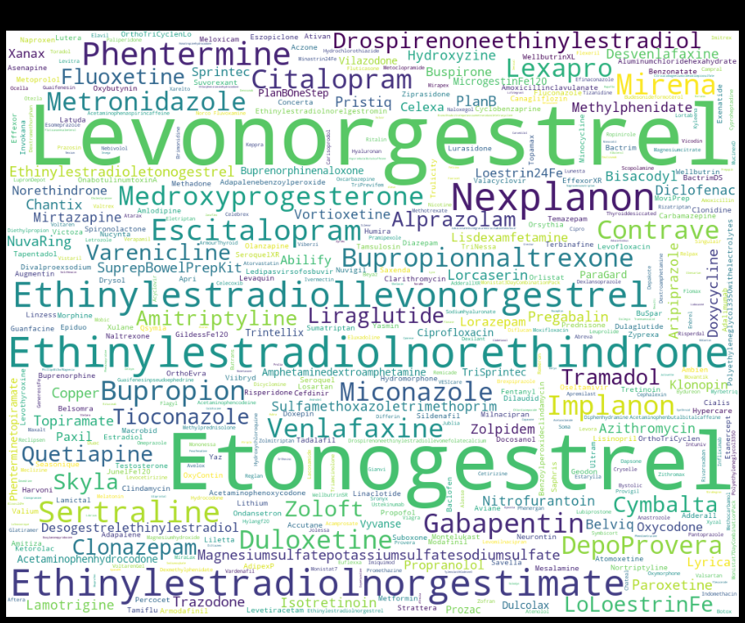
WORD CLOUD FOR DRUG NAMES
Here we can see the names of the drugs which are present in our dataset
We cleaned all the unwanted special characters, numbers that are present in the dataset.

Slide 13

WORD CLOUD FOR CONDITIONS
Here we can see the names of the conditions which are present in our dataset
We cleaned all the unwanted special characters, numbers that are present in the dataset.

Slide 14
REMOVING UNWANTED DATA
Here we removed all the punctuations, numbers by applying lambda function.
And we converted all the reviews into lower case for better results.
Here we used lemmatization technique in order to remove all unnecessary words.
And by importing stopwords we removed all the stop words in reviews column.

Slide 15
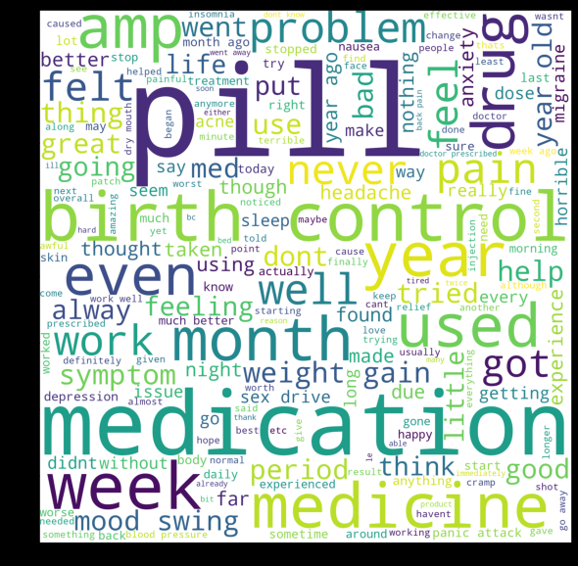
WORD CLOUD FOR REVIEWS
Here we can see the names of the drugs which are present in our dataset
We cleaned all the unwanted special characters, numbers that are present in the dataset.

Slide 16
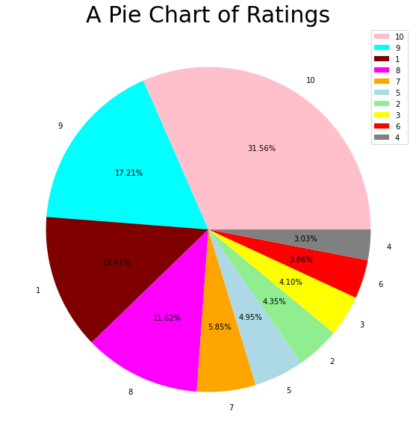
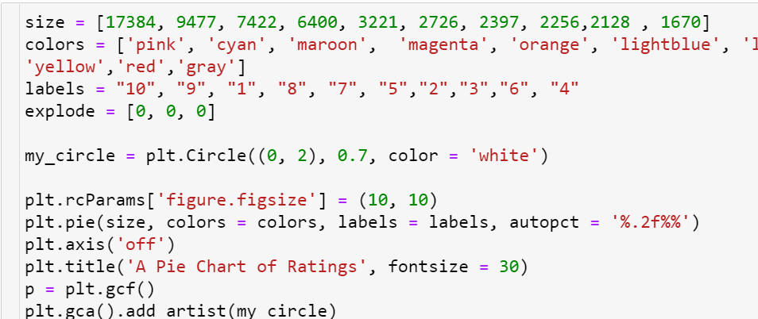
VISUALIZATION OF DATA

Slide 17
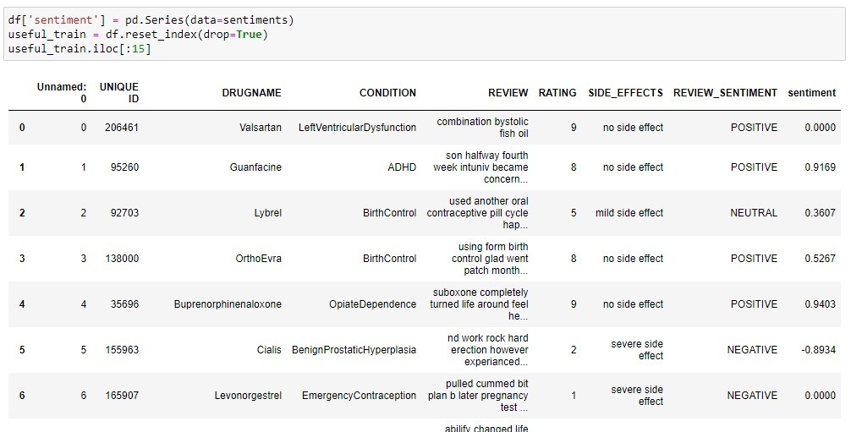
PERFORMING SENTIMENT ANALYSIS

Slide 18
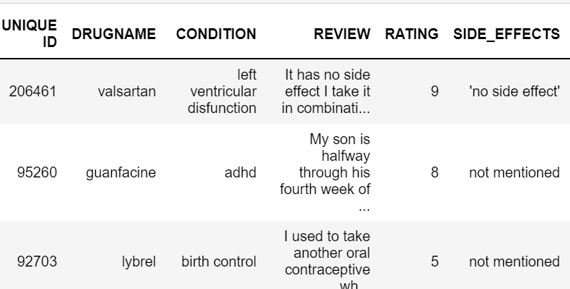
EXTRACTING SIDE EFFECTS FROM REVIEWS
We have extracted the side effects column from reviews by using loops.
We made a word cloud from reviews so that we can able to find out the side effects from reviews.
As we go deep into the side effects column we found that some particular drugs contain more than one side effect. Some are not mentioned in the respective reviews.

Slide 19
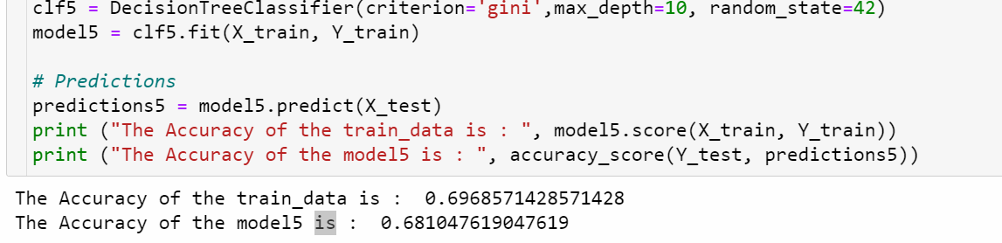
MODEL BUILDING
Here we performed various MODEL BUILDING techniques(DECISION TREE , LGBM CLASSIFIER, LOGISTIC REGRESSION) on our data set.
Here we build a model based on DECISION TREE algorithm.
As we can see that this model has an accuracy of only 69% we are not satisfied with the results of this technique.

Slide 20
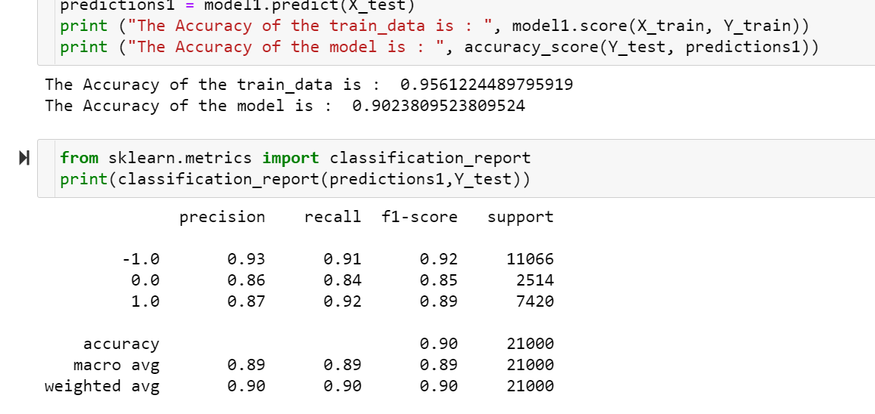
Here we build a model based on LGBM CLASSIFIER algorithm.
As we can see that this model has an accuracy of 95%(train data) and 90%(test data)
we are not satisfied with the results of this model building technique as there is significant difference in the test and train accuracy.
We consider this as a OVERFIT model.

Slide 21
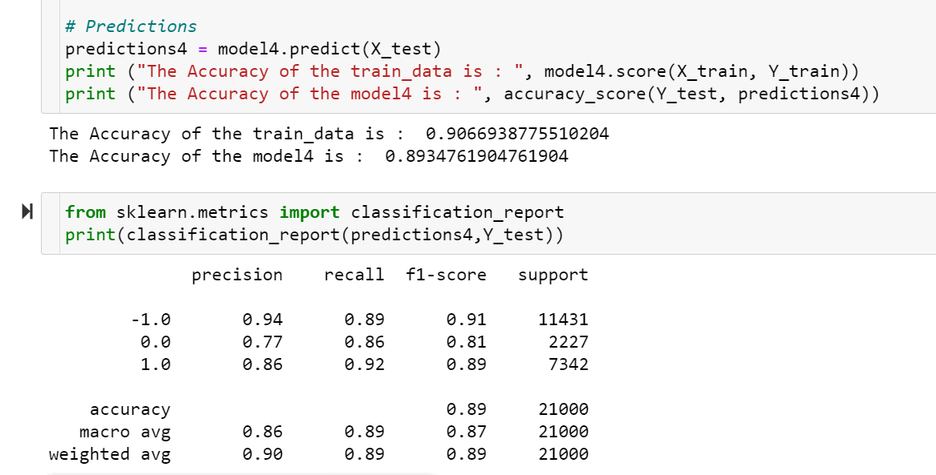
Here we build a model based on LOGISTIC REGRESSION algorithm.
As we can see that this model has an accuracy of 90%(train data) and 89%(test data)
We can see that the model out come was very good so we decided to use the logistic regression algorithm as our model building technique.

Slide 22
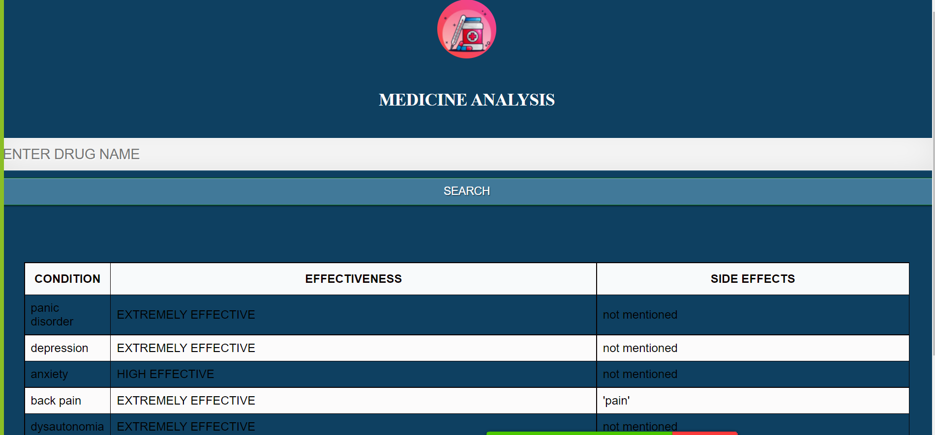
DEPLOYMENT (using FLASK)
The final deployment page of our model is

Slide 23
CHALLENGES FACED
DATA SET CLEANING
EXTRACTING SIDE EFFECTS FROM REVIEW
DEPLOYMENT PAGE USING FLASK

Slide 24
HOW CHALLENGES OVERCOMED
Data cleaning :
as the data set contains very huge unwanted data like null values ,special characters, and numbers.
By using dropna( ) we remove null values.
To remove the punctuations and to convert all uppercase letters to lower case we use lambda function.
Stop words package helped us to remove all the stop words so that model building and deployment will be easy.
By replace function we replaced all the numbers and special characters

Slide 25
Extracting side effects from reviews :
After cleaning all the data we use some looping conditions in order to extract side effects from reviews.
We sorted out some common side effects from all the reviews
We used some conditions so that we will get side effect . If that particular side effect is found in any review.

Slide 26
Deployment using flask :
As we are not aware of HTML/ CSS we faced a bit difficulty but by exploring more on that we finally able to build the deployment page.

Slide 27
THANK YOU

